Slide 1
From UX to SX (Social Experience):
Privacy research lessons for the data-intensive public sphere
Daniel J. Weitzner <weitzner@mit.edu>
Principal Research Scientist, CSAIL
Founding Director, MIT IPRI
Notes:
Thanks to Pablo
Privacy at the beginning of a rich agenda - either very important or get it out of the way. I’ll assume it’s the latter.

Slide 2
Overview
How to think about privacy
Modern privacy: lessons from privacy UX research for Social Experience design goals
  Privacy as control
  Privacy as freedom of association
  Privacy as Security
  Privacy as accuracy
  Privacy as accountability

Slide 3
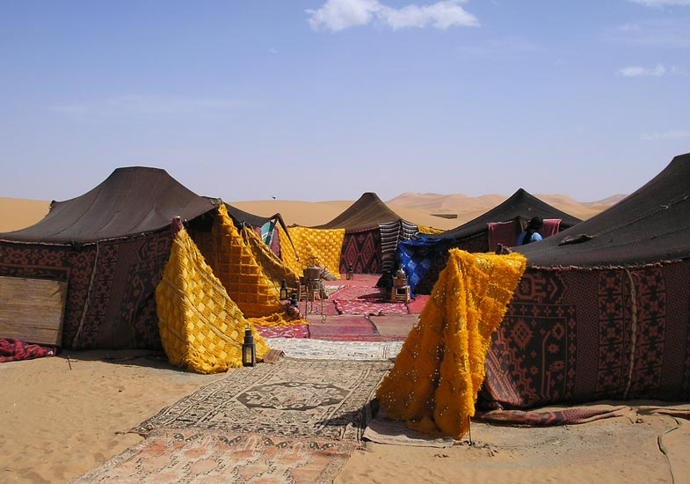
Privacy ‘in the beginning’
מַה טֹּבוּ אֹהָלֶיךָ יַעֲקֹב מִשְׁכְּנֹתֶיךָ יִשְׂרָאֵל
Bala’am: “How lovely are your tents, Jacob, your settlements, Israel” (Num. 24:5)
Rashi: “For he saw that the entrances were not facing each other”
Notes:
Rashi explains – the tent entrances were askew.
-by the way – only traditional prayer included in our liturgy credited to a non-Jew.

Slide 4
Privacy as Architectural guidance
Rashi: “For he saw that the entrances were not facing each other.”
Mishnah: In a courtyard which he shares with others, a man should not build a door facing another person’s door nor a window facing another person’s window. If it is small he should not enlarge it…..
Notes:
Rashi’s commentary is expanded to laws on architectural principles that respect privacy

Slide 5

Limits on State authority to intrude on the individual
SIR EDWARD COKE:
“That the house of everyone is to him as his castle and fortress, as well for his defence against injury and violence, as for his repose”
“That in all cases when the King is party, the sheriff (if the doors be not open) may break [into] the party's house, either to arrest him or to do other execution of the King's process, if otherwise he cannot enter. But before be breaks [into] it, he ought to signify the cause of his coming and to make request to open the doors.
Semayne's Case
COURT OF KING'S BENCH
All ER Rep 62
Michaelmas Term, 1604

Slide 6
Does privacy mean being alone?
“The makers of our Constitution undertook to secure conditions favorable to the pursuit of happiness….They conferred, as against the government, the right to be let alone - the most comprehensive of rights and the right most valued by civilized men.”
  OLMSTEAD v. U.S., 277 U.S. 438 (1928)(Brandeis dissenting)
Notes:
Tension here – two polls of privacy: alone….

Slide 7
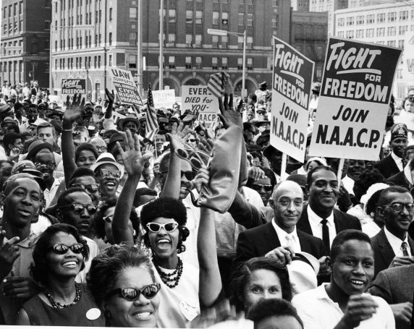
Or, working together?
This Court has recognized the vital relationship between freedom to associate and privacy in one's associations…. Inviolability of privacy in group association may in many circumstances be indispensable to preservation of freedom of association, particularly where a group espouses dissident beliefs.
NAACP v. Patterson - 357 U.S. 449 (1958)
Notes:
We have many privacy values that go far beyond secrecy and are important to the way our society functions as a whole.

Slide 8
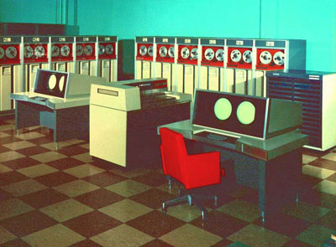
Modern privacy begins in the mainframe era
Fair Information Practice Principles: (FIPPs)
Collection Limitation
Data Quality
Purpose Specification
Use Limitation
Security Safeguards
Openness
Individual Participation
Accountability
Notes:
The increasing affordability of mainframe computers in the 1970s gave rise to fears about unfairness and discrimination by big corporations and big government.

Slide 9
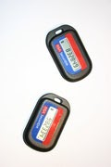

Detour: traditional computer science view of privacy
Privacy is the claim of individuals, groups, or institutions to determine for themselves when, how, and to what extent information about them is communicated to others.
Alan Westin, Privacy and Freedom (1967)
Jerry Salzer/Mike Schroeder (CACM 1974)
Notes:
Detour is enshrined in computer science perspective on designing privacy into systems.

Slide 10

Detour - in poetry
“You can have my encryption algorithm when you pry my cold dead fingers from my private key.”
John Perry Barlow, co-founder Electronic Frontier Foundation (1994)
Notes:
Privacy becomes principally about secrecy.
Reasons:
Individualistic ethos of PC users
Hammer/nail: crypto tools pretty sophisticated

Slide 11
Modern Approaches to Privacy - seek sources of trust

Slide 12
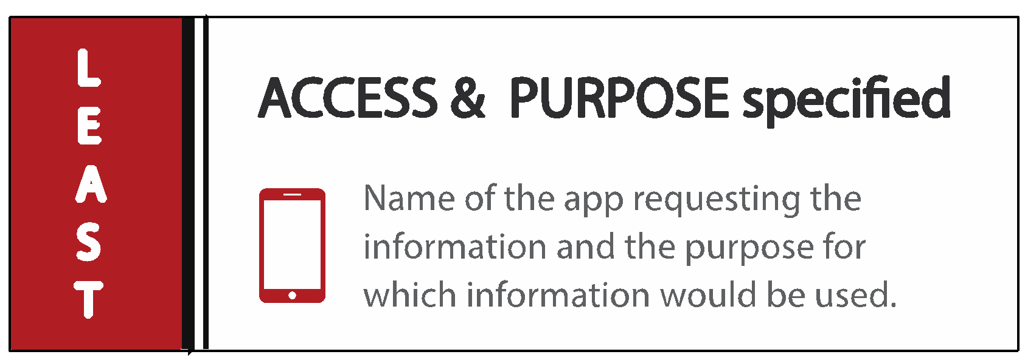
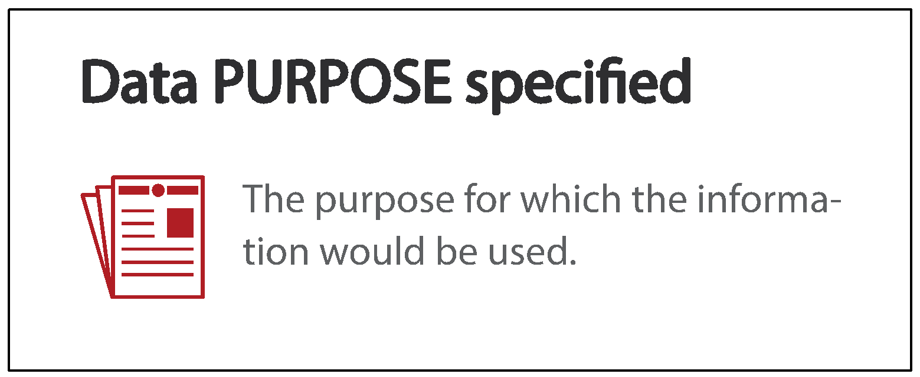
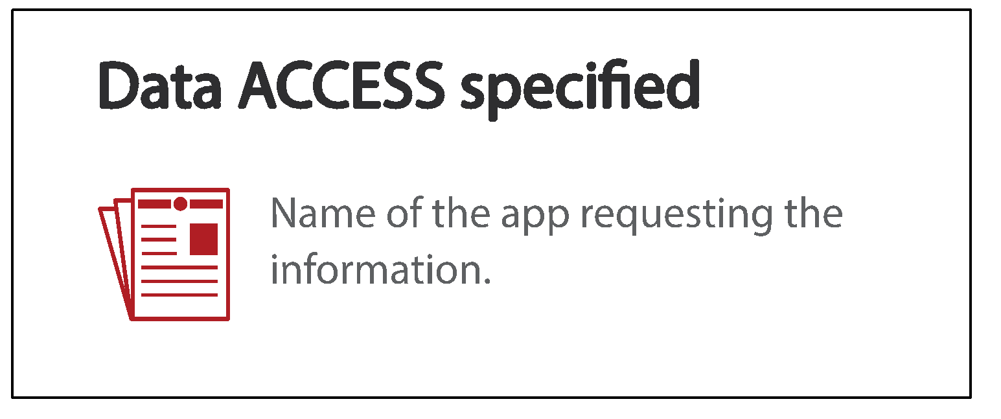
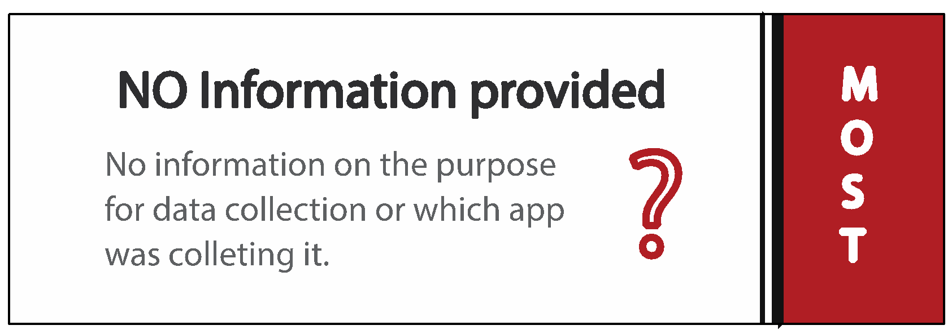
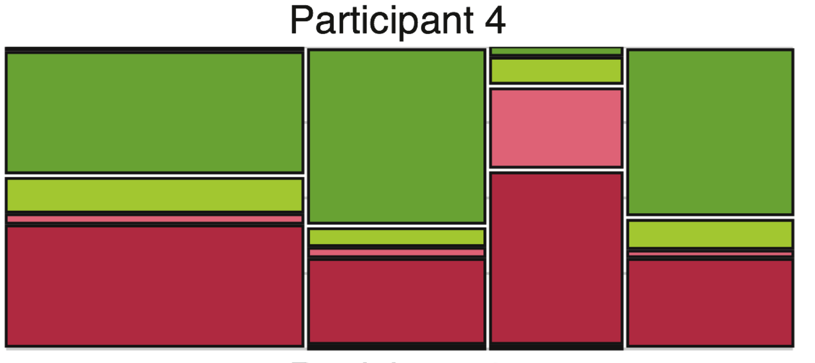
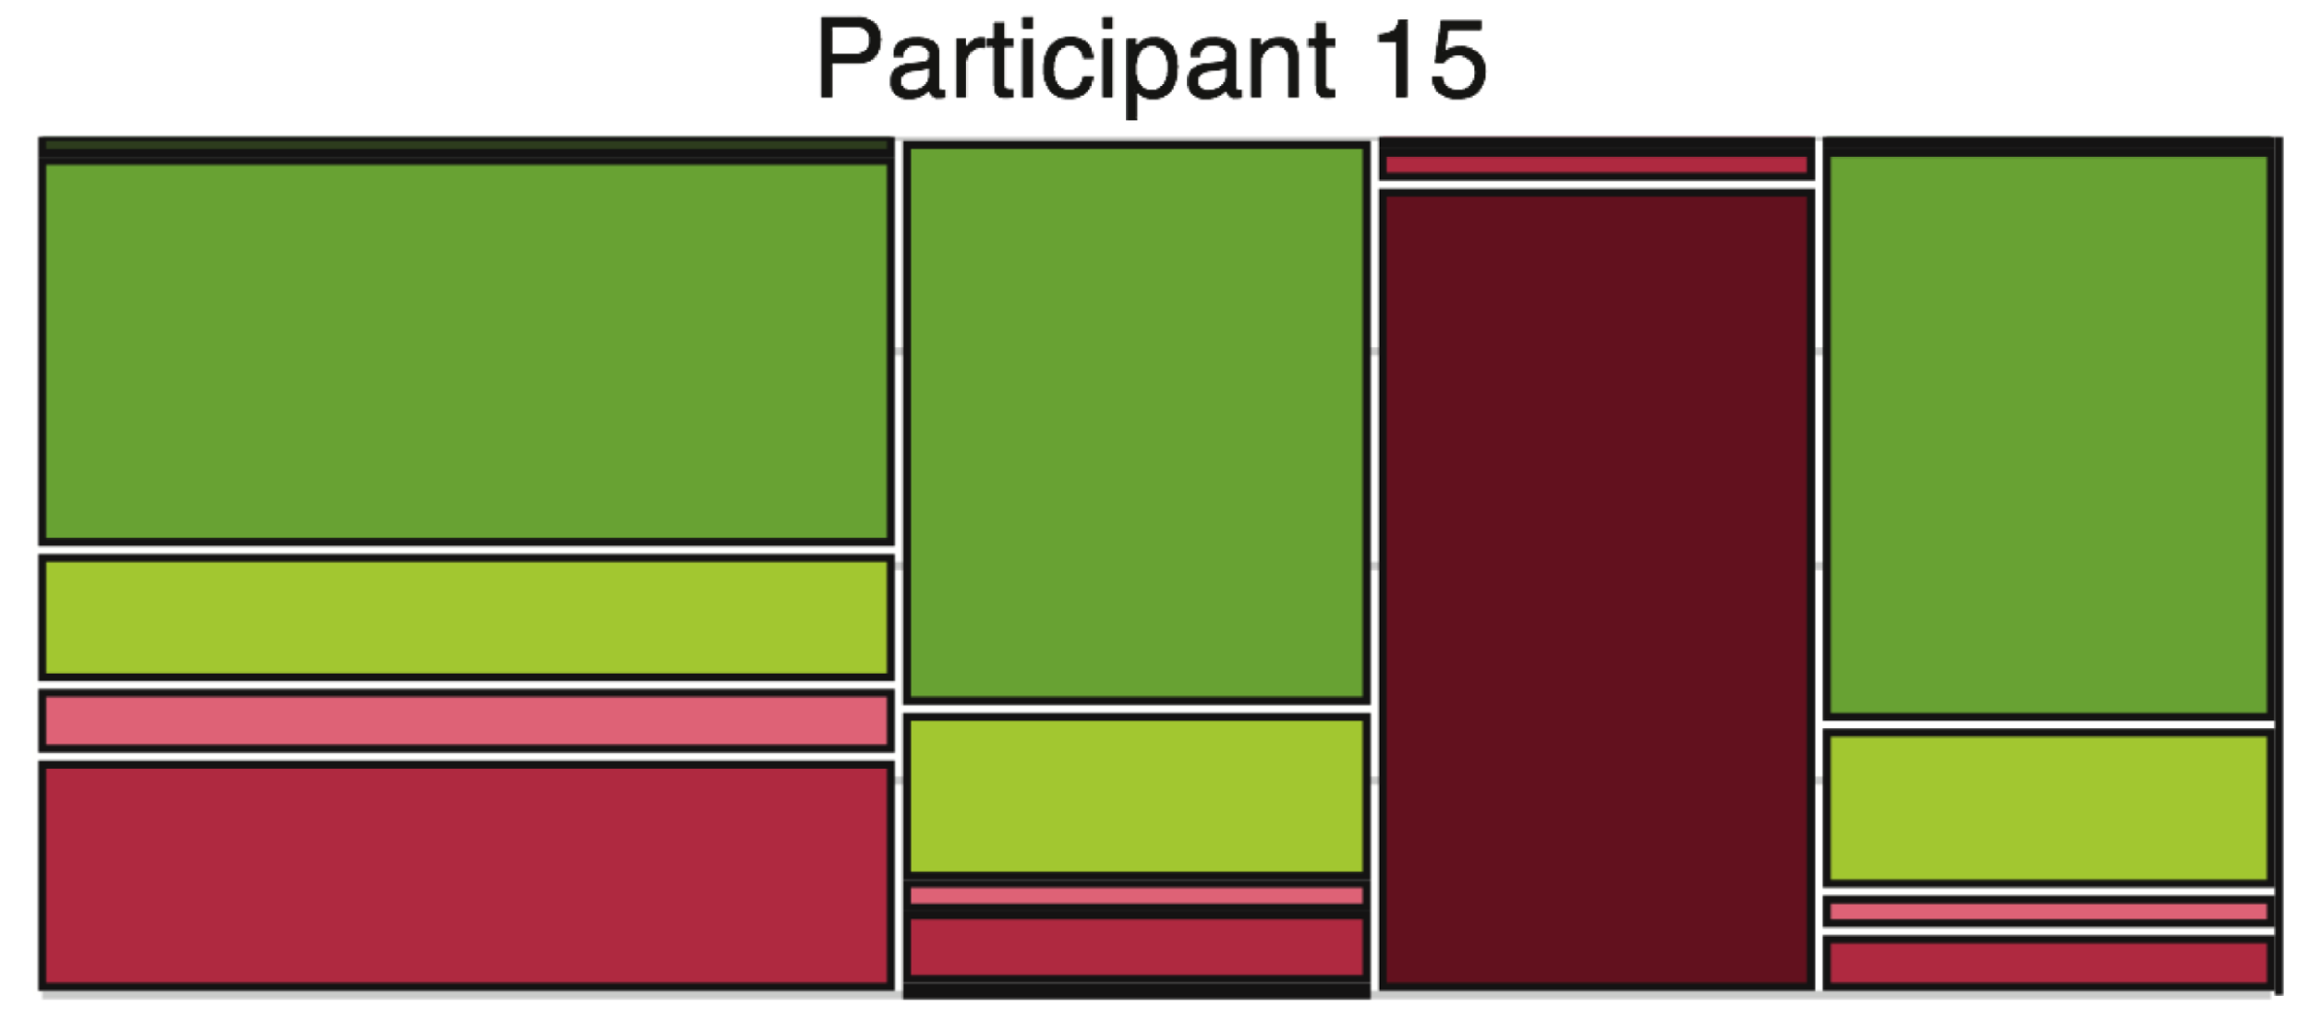
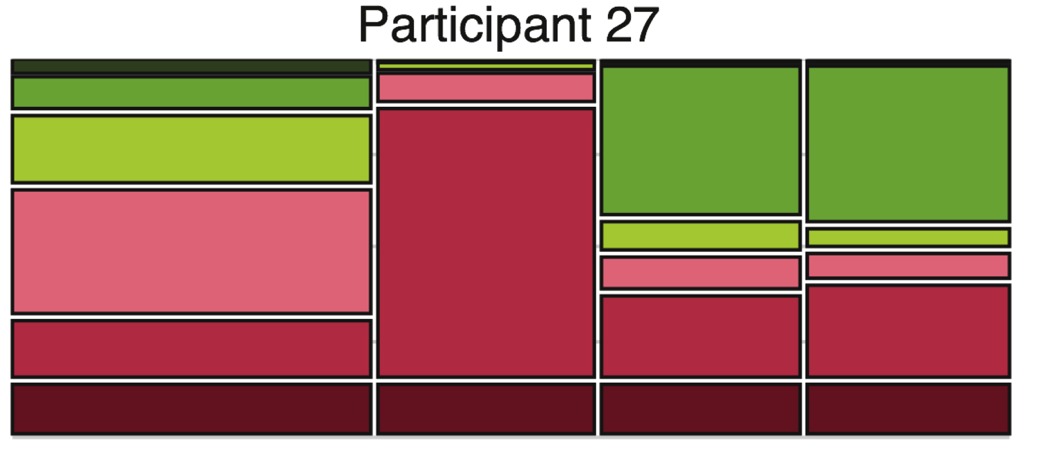
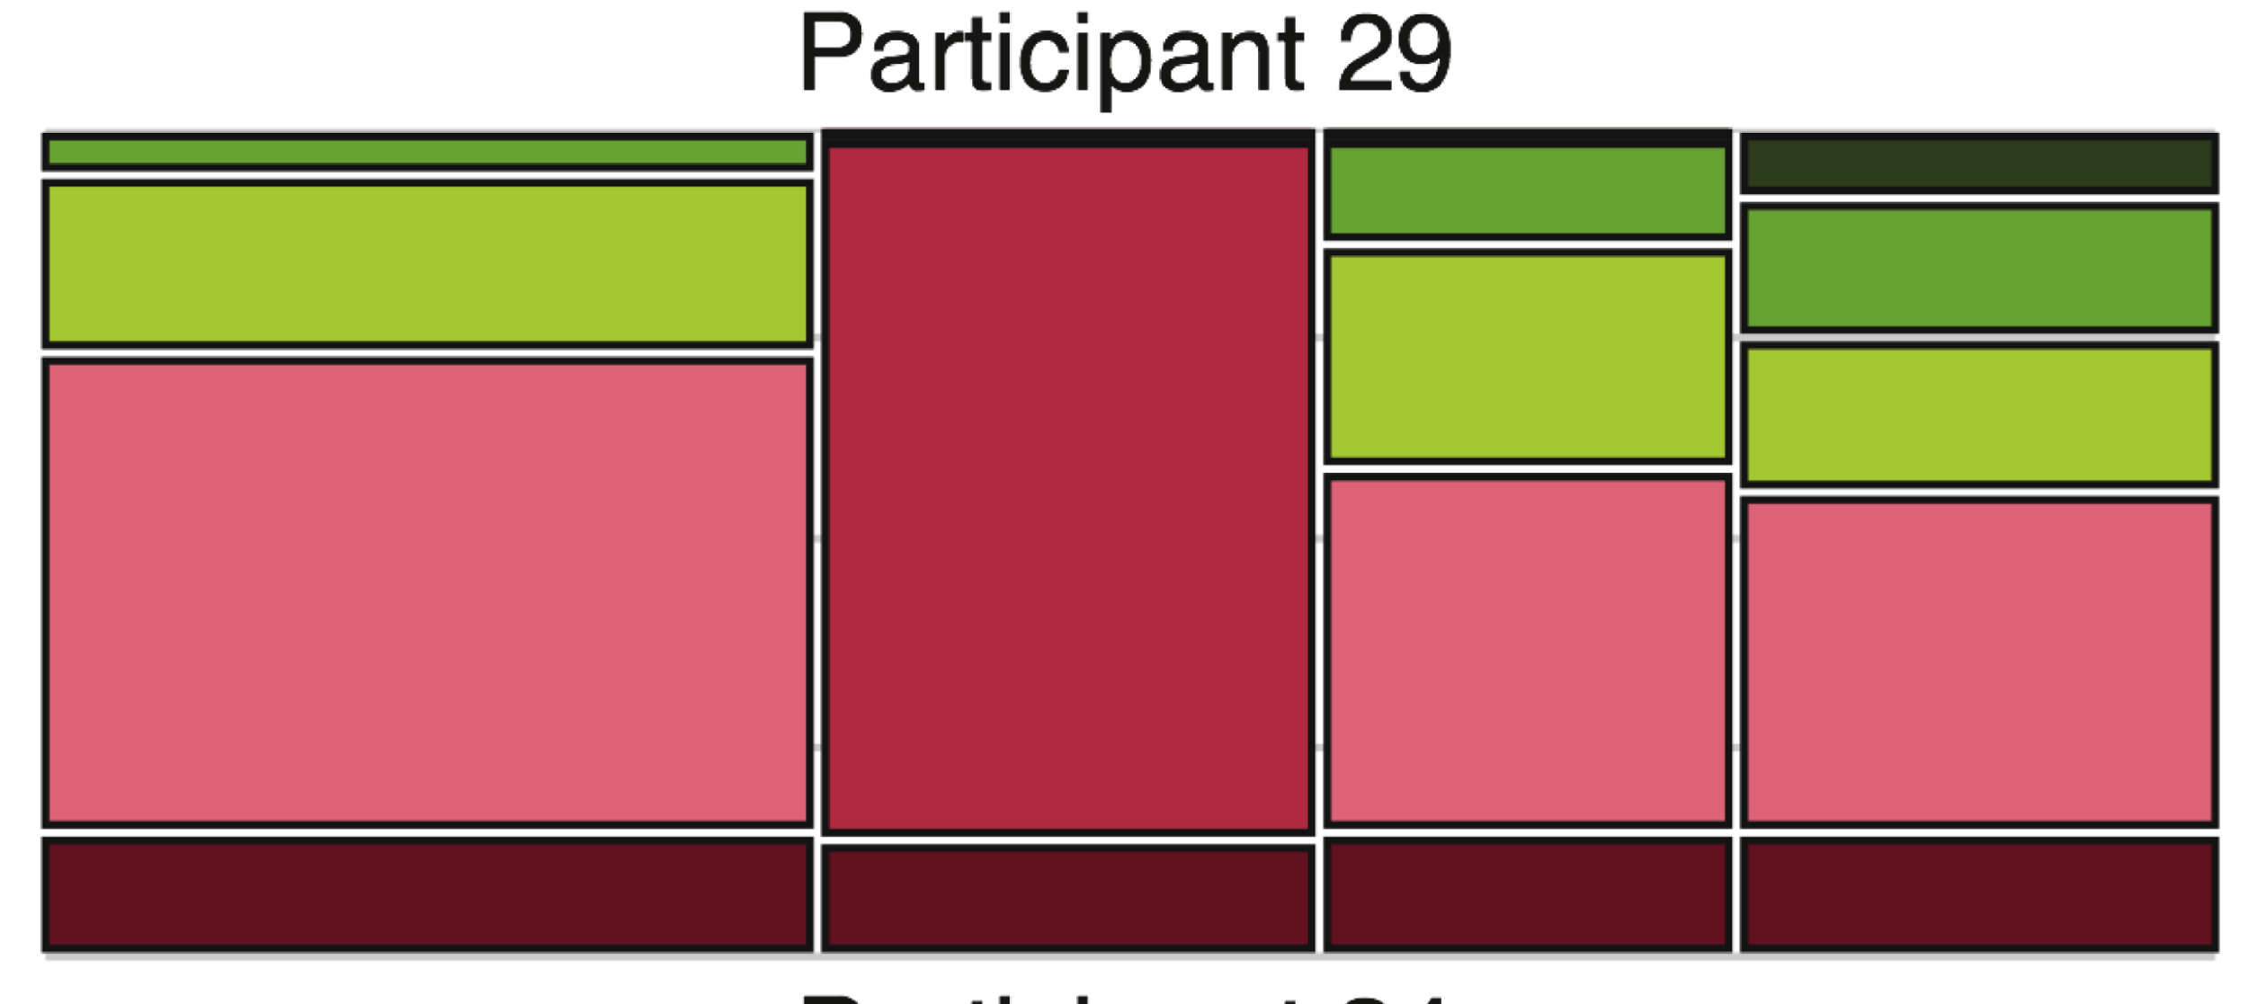
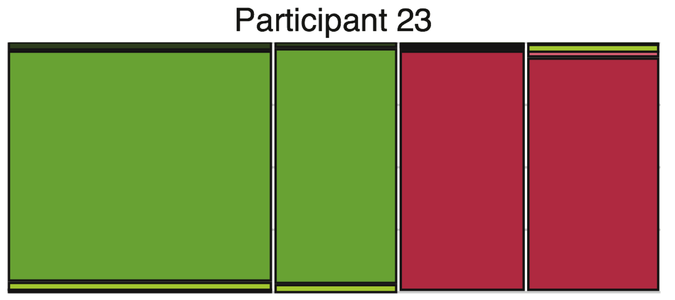
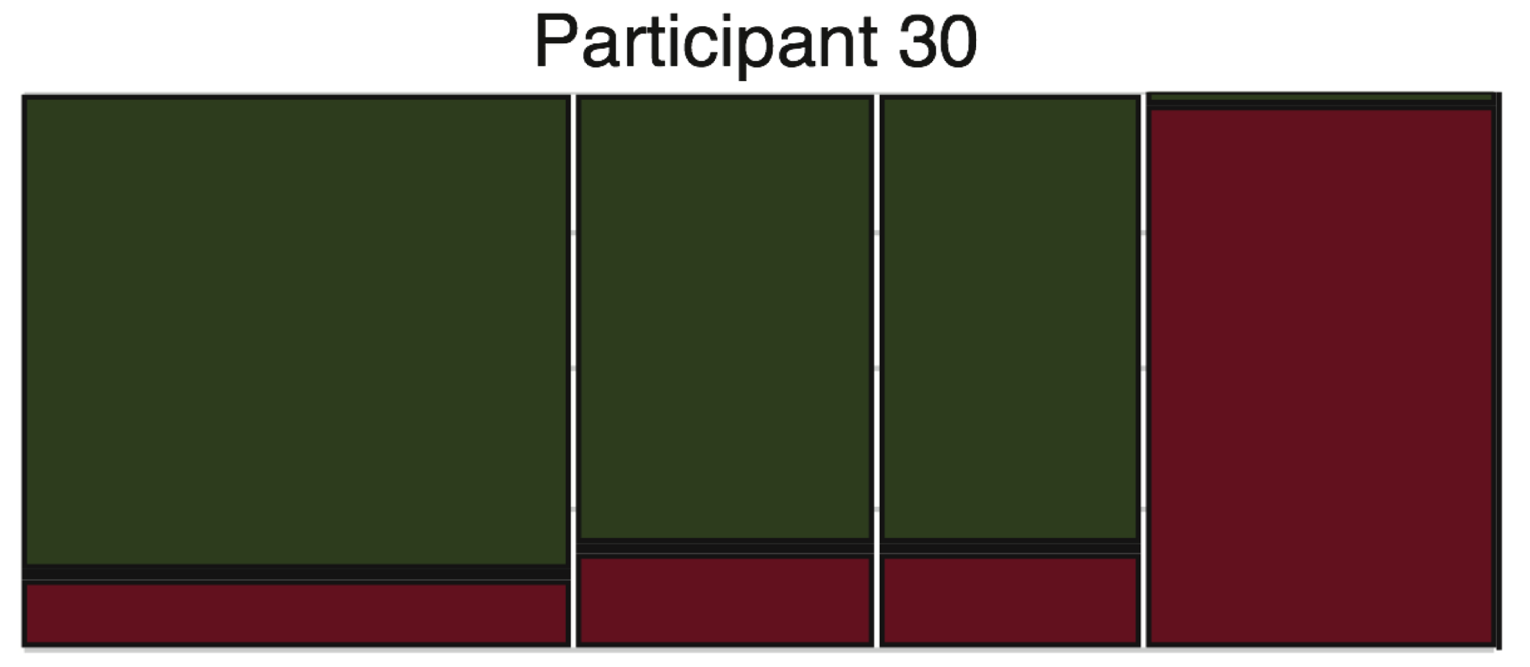
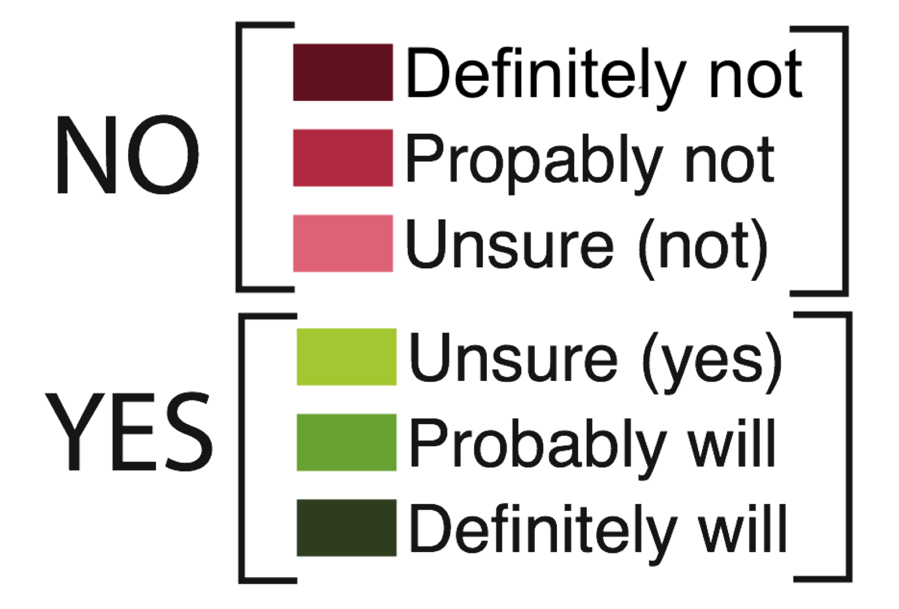
Privacy as familiarity
*
Participants based their decision on:
Familiarity (i.e. trust) with the app.
The type of app, in particular what kinds of information the app already has already access to.
No App Low Med. High
No App Low Med. High
*
*
*
Frequency of use had no effect;
No App Low Med. High
No App Low Med. High
Privacy Tipping Points in Smartphones Privacy Preferences
F Shih, I Liccardi, D Weitzner – Proceedings ACM CHI, 2015
No App Low Med. High
No App Low Med. High
Notes:
* These participants did not share their personal information when the purposes displayed within the question did not show a conceivable gain to them. Otherwise they based their decision on the app. Even when the purposes displayed within the questions were tailored to have a clear and conceivable gain for them, they still would not share their personal information with certain apps.

Slide 13
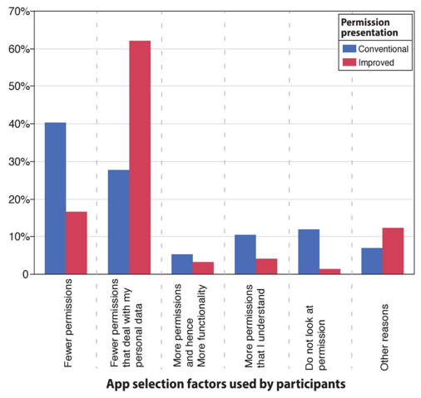
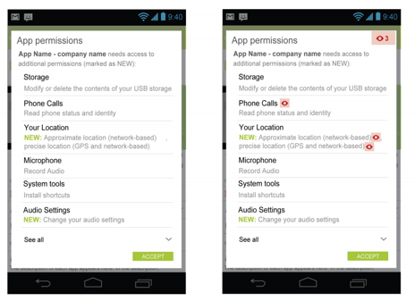
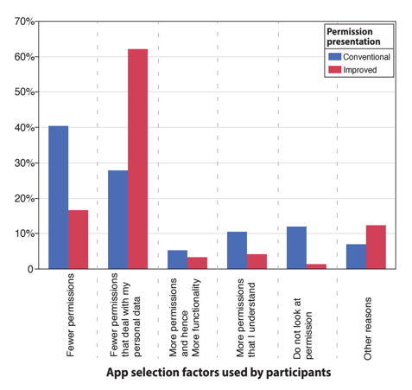
Privacy as Control
Before
Users focused solely on the total number of permissions requested
After
Users now focused on number of permissions asking for personal data
Zhang, Frances, Fuming Shih, and Daniel Weitzner. "No surprises: measuring intrusiveness of smartphone applications by detecting objective context deviations." Proc.12th ACM workshop on Workshop on privacy in the electronic society. ACM, 2013.

Slide 14
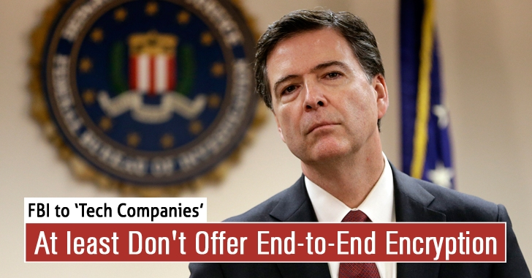
Privacy as Free Association

Slide 15
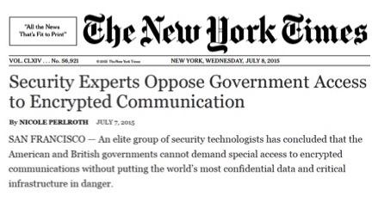
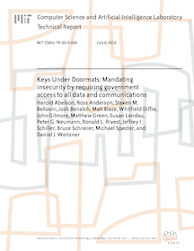
Loss of Trust from Insecurity
Challenge: Law enforcement officials are again calling on technology designers to dumb down user’s Internet security to enable guaranteed access to all data and communications, even if encrypted.
15 experts, including the world’s leading cryptographers show there are grave risks to building “exceptional access” systems for law enforcement.
Once those back doors are available, all of our private communications become much more vulnerable to attack by malicious criminals and terrorists.

Slide 16

Insecurity = Market risk

Slide 17
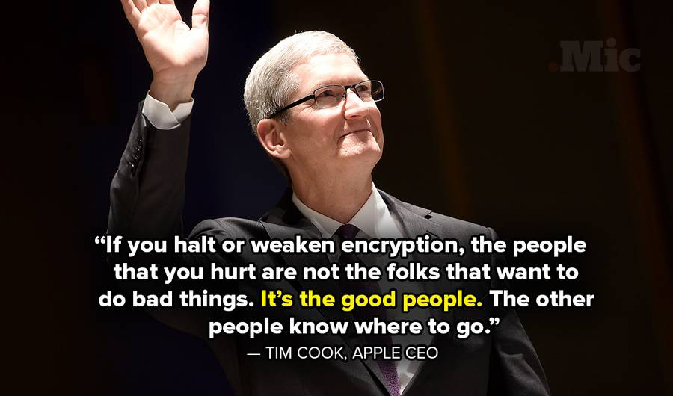
Market Necessity: Defend your users

Slide 18
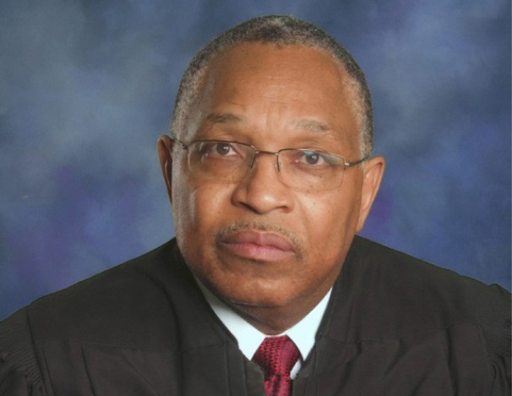
Accountability Challenge
1. Transparency without trust
“the court lacks the tools to independently verify how often the government’s surveillance breaks the court’s rules that aim to protect Americans’ privacy”
Judge Reggie B. Walton, Chief Judge, Foreign Intelligence Surveillance Court
Washington Post, August 15, 2013

Slide 19
Privacy as Accuracy and Accountability
Fair Credit Reporting Act (1970):
You must be told if information in your file has been used against you.
You can find out what is in your file.
You are entitled to free reports if a person has taken adverse action against you because of information in a report;
You have a right to know your credit score.
You can dispute inaccurate information with the consumer reporting agency.
You may seek damages from violators.
Notes:
The increasing affordability of mainframe computers in the 1970s gave rise to fears about unfairness and discrimination by big corporations and big government.

Slide 20
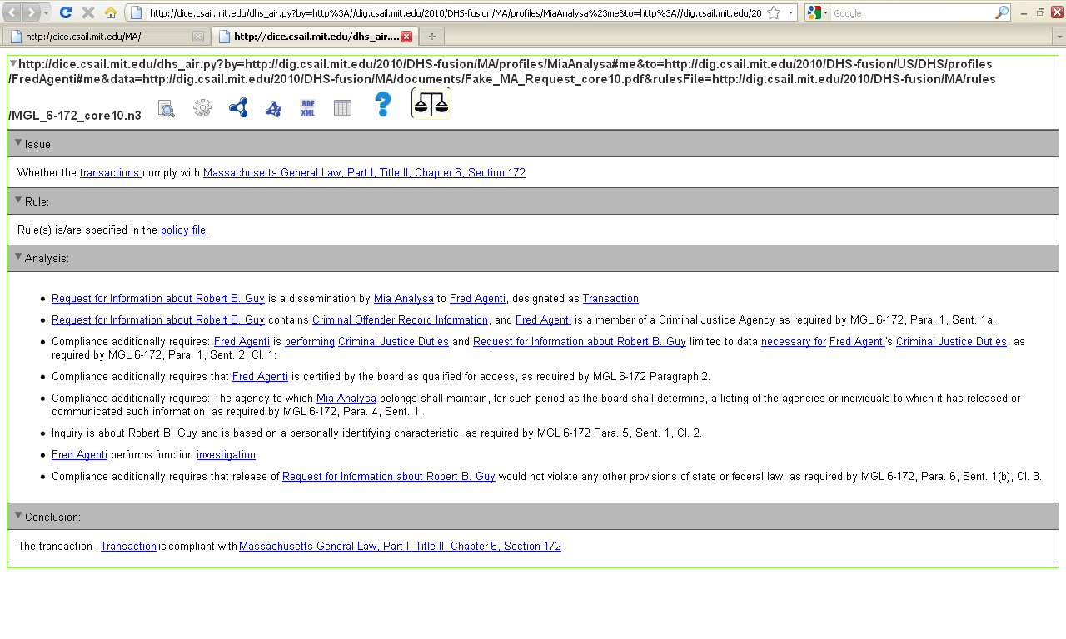
Modern accountable systems
“[Recipient,] Fred Agenti, is a member of a
Criminal Justice Agency…”
“Inquiry is about Robert B. Guy and is based on a
personally identifying characteristic…”

Slide 21
From UX → SX: Guideposts for Privacy Design
Control
Familiarity
Accuracy
Free Association
Security
Accountability

Slide 22
Thank you

