Slide 1
Grid Data Science for Smart Grid
Data Models, Platforms and Analytics to Accelerate Smart Grid R&D
Sila Kiliccote
silak@slac.stanford.edu
LIDS/IDSS Workshop on Smart Urban Infrastructures, May 12, 2017

Slide 2
Outline
1. What is smart about Smart Grid?
2. What are the challenges facing the operation of the smart grid? Where is research critical?
3. What’s the expected impact of academic research in this area?
4. To what extent are these challenges 'systems and control' challenges vs. technology?
5. What are the challenges in engaging consumers through pricing and other incentives?
6. Do we expect to see fundamental changes in the operation of the Grid? For example, new markets, new pricing mechanisms…etc.

Slide 3

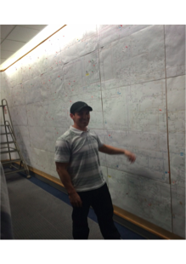

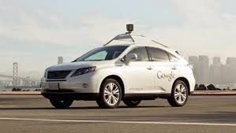

Smart Grid
Data
Synthesized Information
Automation
Autonomous Operation
Notes:
Come up with a relevant use case (or use cases) which can resonate with the launch crowd. (Work that up as an example(s))
-Look at social explorer

Slide 4

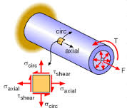

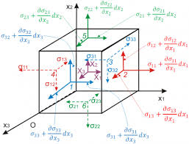
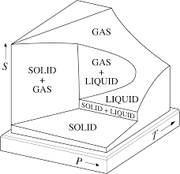
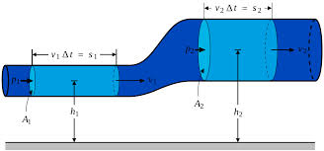
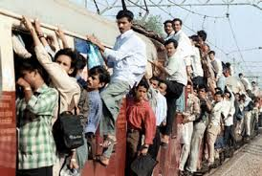
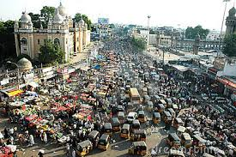
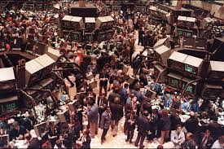
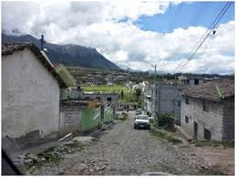
Modeling is central to engineering...
Systems modeled with basic equations that capture the phenomenon in a mathematical form
We don’t have ‘basic equations’ for social, medical, behavioral, economic and other complex phenomena
Source: Guha Ramanthan

Slide 5

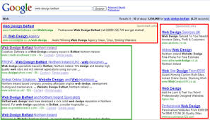
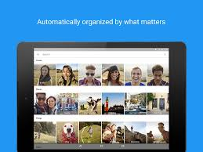
Empirical (Data-driven) modeling and its success…
Take lots of data and fit the curve … (No causal equations required)
Lots of data and compute power
Massively successful in the last 10 years
  Spell Correction
  Web search and advertising
  News feed
  Perception: Vision, speech
  (Mostly web-ecosystem products)
Source: Guha Ramanthan

Slide 6
The perfect convergence of factors
Data Availability
  Increased digitization of research
  Emergence of IoT and availability of smart meter and telemetry data
Economic Factors
  Cheap storage allows low cost preservation of data
  Cheap sensors allow for continuous collection
Awareness Factors
  Growing awareness of importance of research data
  Growing awareness of importance of sharing research data
  Growing awareness of importance of reproducibility of data driven research

Slide 7
Successful Research Data
Trusted
Reusable
Reproducible
Reviewed
Comprehensible
Shared
Citable
Discoverable
Accessible
Saved
Preserved
Stored
10 aspects of highly effective research data, By Anita de Waard, Helena Cousijn, PhD, and IJsbrand Jan Aalbersberg, PhD Elsevier, Posted on 11 December 2015

Slide 8
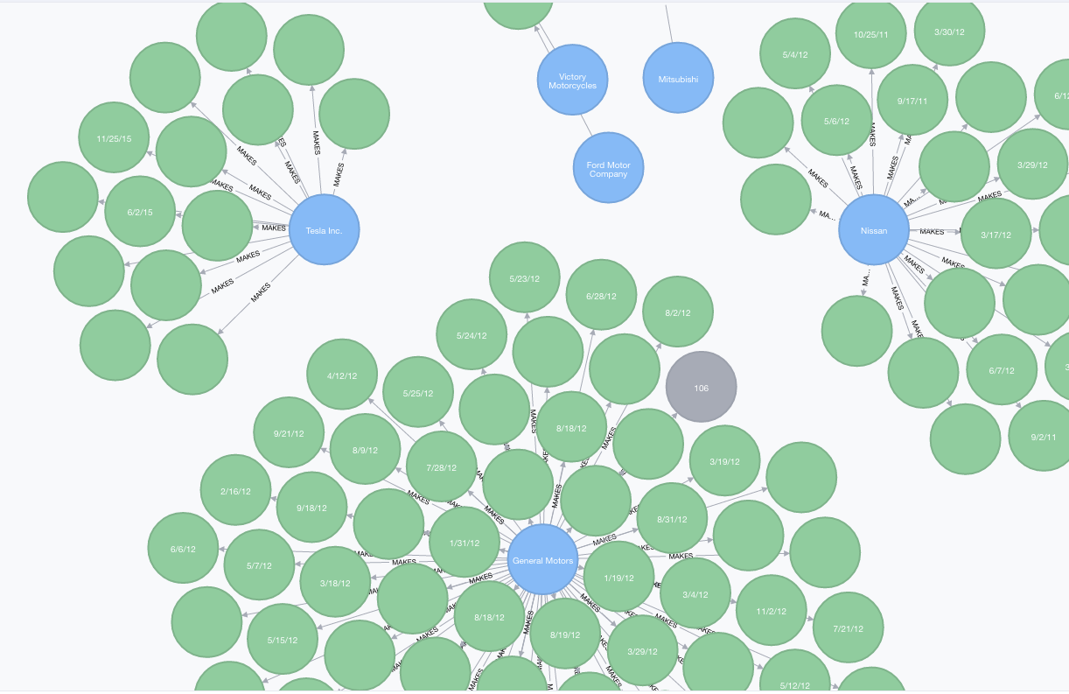
We believe we can manage grid data with a schema-free graph database that allows us to visually examine relationships, clustering, and orphan data and provide near real-time insights.
Early implementation of Pecan Street EV Data
Exploring new ways to bring together datasets:
“Reference by Description”
Notes:
Graphs are inherently more suitable than RDBMS for making sense of complex interdependencies central to managing and operating the smart grid

Slide 9
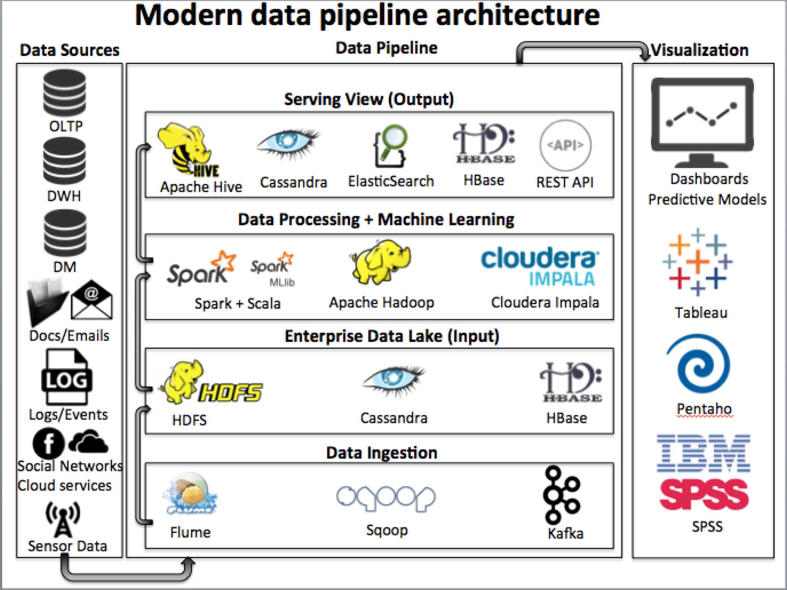
Common Architecture and Product Ecosystem

Slide 10
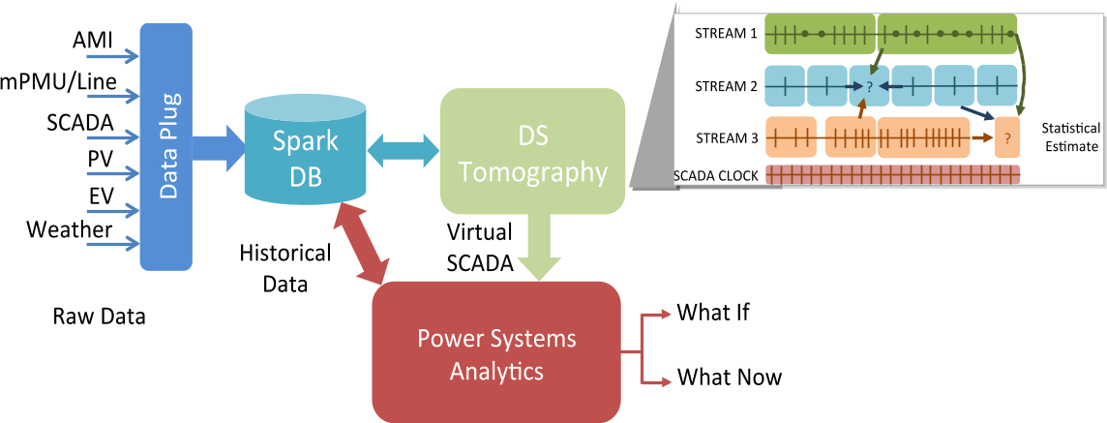
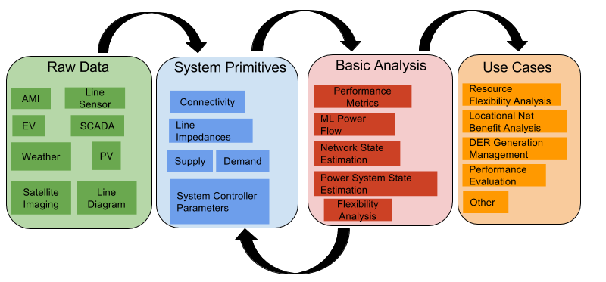
Distribution Grid as a key application space:
VADER - Visualization and Analytics for DERs
Funded by DOE, SunShot Initiative

Slide 11


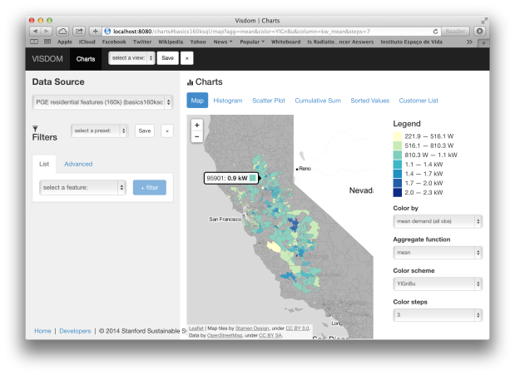




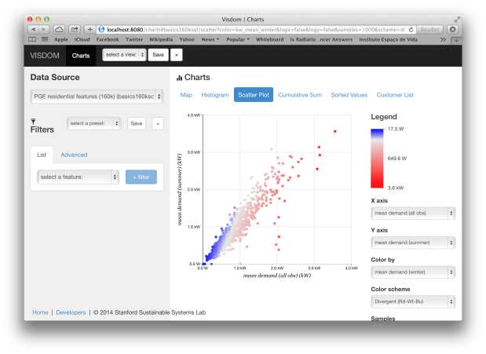




Open-source Visualization and Insight for Demand Operations and Management platform
Data cleansing, management
Demand feature extraction
Targeting
Segmentation
Open-source R and python libraries & workflow
Visualization & exploration website
Adoption, partnership and support
Response models
Measurement &
Verification
Forecasting
Pricing
Funded by DOE, ARPA-e PI: Ram Rajagopal

Slide 12
Multi-disciplinary innovative approach is needed to tackle challenges
Within Engineering
Outside of Engineering
Power
System
Buildings
TECHNOLOGY
MARKETS
B2G
μgrids
POLICY
Mobility
VGI
V2B

Slide 13
Key needs - Grid Data Science
Revolutionize energy data sharing
Enable cross-domain, data-driven, multi-disciplinary research while supporting privacy and security of data
Allow for peer-reviewed, high quality and high impact research
Make research reproducible and transparent
Increase data science, ML and AI capabilities within the industry and workforce

Slide 14
Thank you!
Sila Kiliccote
Staff Scientist, GISMo@SLAC
SilaK@SLAC.Stanford.edu

